Slide 1

Control Structures - Loops and Conditional Statements in C# for Unity

Slide 2
Learning Objectives
Understand the role of control structures in programming.
Learn how to use loops for repetitive tasks.
Learn how to use selection and conditional statements for decision-making
Learn how to set up your sprites and manage them with different components
Understand Prefabs
Understand Prefabs and Instantiation
Understand Game Object Destruction
Learn how to create basic movement

Slide 3
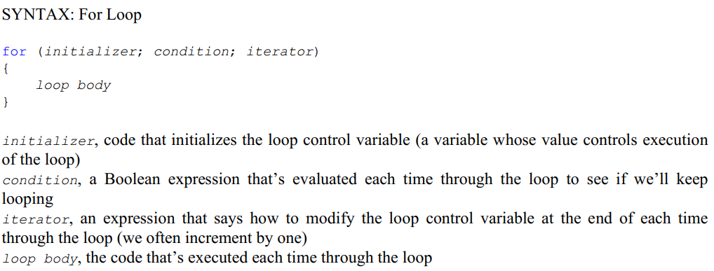
Loops in C#
for Loops
Image source: Unity.com

Slide 4
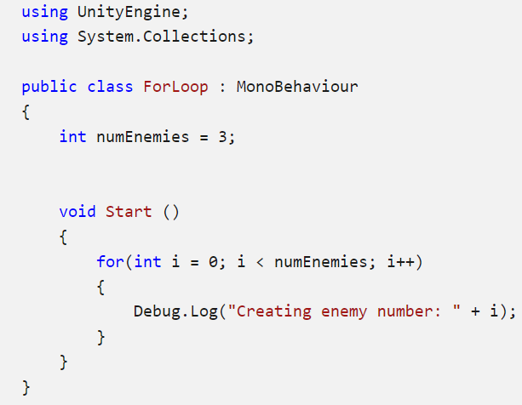
Loops in C#
for Loops
Image source: Unity.com

Slide 5
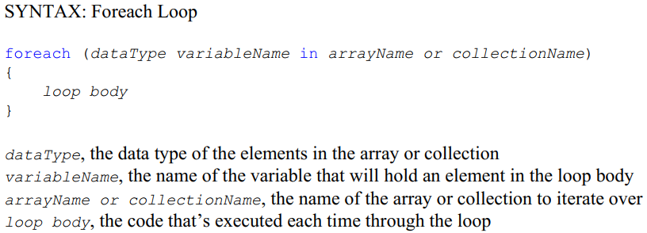
Loops in C#
foreach Loops
Image source: Unity.com

Slide 6
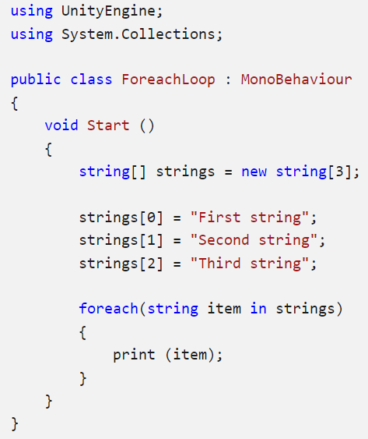
Loops in C#
foreach Loops
Image source: Unity.com

Slide 7
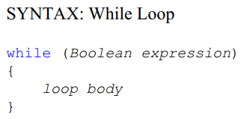
Loops in C#
while Loops
ITM
Initialize the variables contained in the Boolean expression.
Tests the Boolean expression to see if the loop body should execute or not.
Modify at least one of the variables in the Boolean expression (give it a new value).
Image source: Unity.com

Slide 8
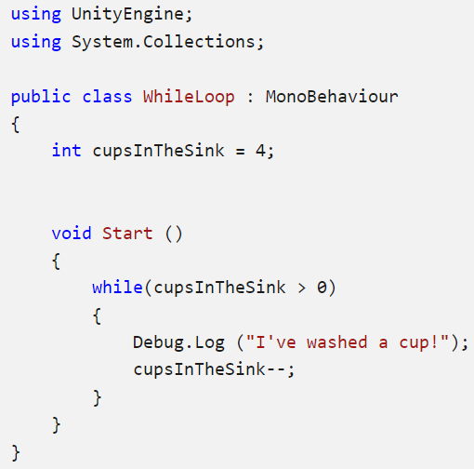
Loops in C#
while Loops
Image source: Unity.com

Slide 9
Loops in C#
while Loops
Image source: Unity.com

Slide 10
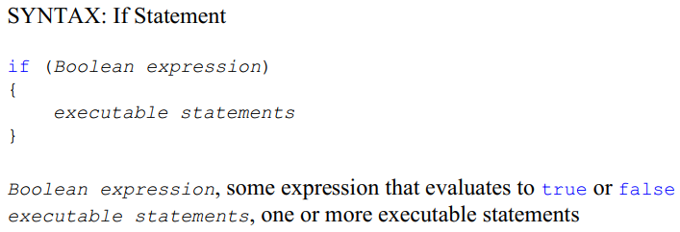
Conditional Statements
Image source: Unity.com

Slide 11
Conditional Statements
A number of relational operators in C# that let us compare two things:
==, equal to !=, not equal to <, less than <=, less than or equal to >, greater than >=, greater than or equal to
Image source: Unity.com

Slide 12
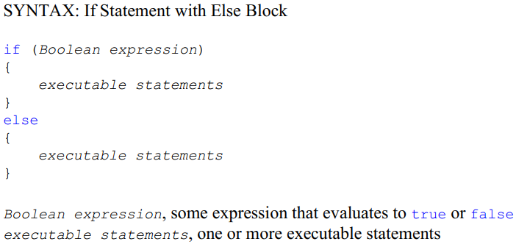
Conditional Statements
Image source: Unity.com

Slide 13
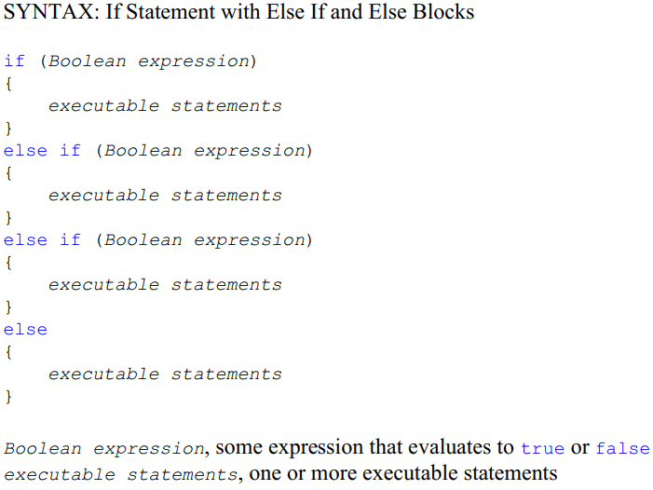
Conditional Statements
Image source: Unity.com

Slide 14
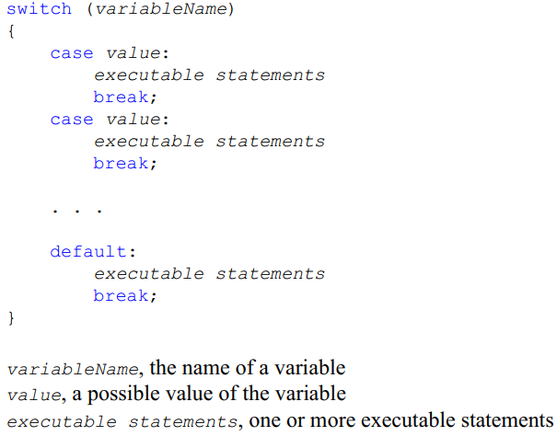
Switch Statements
Image source: Unity.com

Slide 15
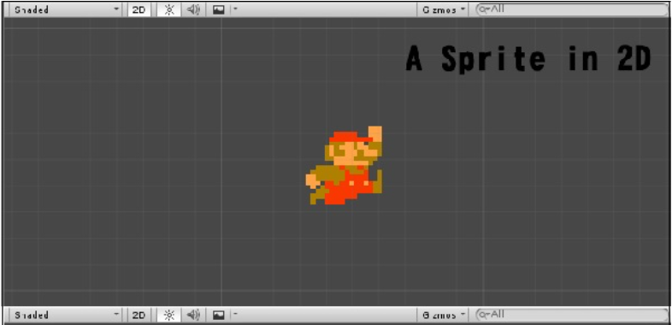
Work with sprites
Sprites are simple 2D objects that have graphical images (called textures) on them. Unity uses sprites by default when the engine is in 2D mode. When viewed in 3D space, sprites will appear to be paper-thin, because they have no Z-width.
Sprites always face the camera at a perpendicular angle unless rotated in 3D space.
Image source: Unity.com

Slide 16
Work with sprites
Set up sprites:
1. Import your image
Import sprites into project through one of the following methods:
In your computer’s File Explorer (macOS: Finder), place your image directly into your Unity project’s Assets folder. Unity detects this and displays it in the Project view.
In Unity, go to Assets > Import New Asset. From the File Explorer (macOS: Finder) window that opens, select your chosen image. Unity displays your chosen image in the Project view.
2. Set imported image as a sprite
If you set your project to 2D, Unity automatically sets the image you import as a sprite. Unity will also automatically create sprites based on the Automatic Slicing behavior in Sprite Editor window. If you set your project to 3D instead, Unity imports your image as a texture.
To change the asset’s Texture Type:
Select the asset to access its Import Inspector
Set the Texture Type to Sprite (2D and UI).
Image source: Unity.com

Slide 17
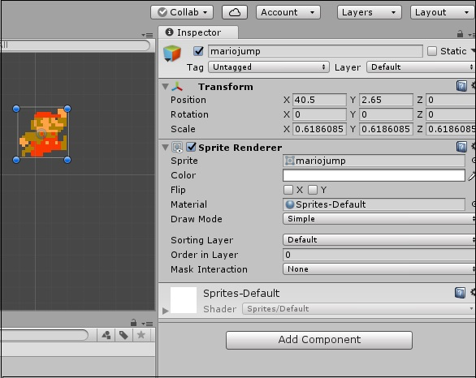
Work with sprites
Whenever Unity makes a new sprite, it uses a texture. This texture is then applied on a fresh GameObject, and a Sprite Renderer component is attached to it. This makes our GameObject visible with our texture, as well as gives it properties related to how it looks on-screen.
Image source: Unity.com

Slide 18
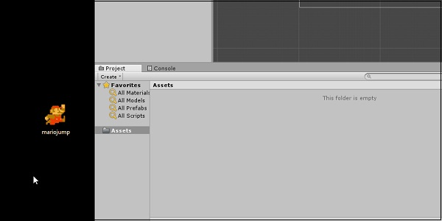
Work with sprites
To create a sprite in Unity, we must supply the engine with a texture.
Let us create our texture first. Get a standard image file such as a PNG or JPG that you want to use, save it, and then drag the image into the Assets region of Unity.
Image source: Unity.com

Slide 19
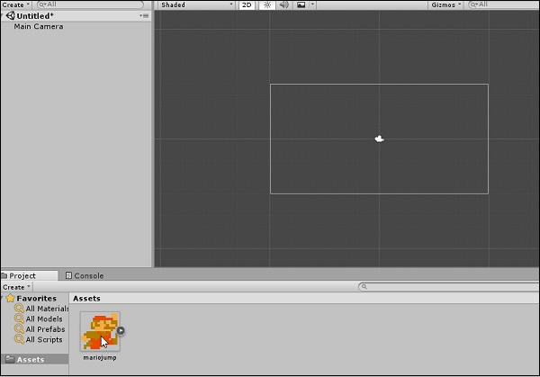
Work with sprites
Next, drag the image from the Assets into the Scene Hierarchy. You will notice that as soon as you let go of the mouse button, a new GameObject with your texture’s name shows up in the list. You will also see the image now in the middle of the screen in the Scene View.
Image source: Unity.com

Slide 20
Work with sprites
Let us consider the following points while creating a sprite:
By dragging from an external source into Unity, we are adding an Asset.
This Asset is an image, so it becomes a texture.
By dragging this texture into the scene hierarchy, we are creating a new GameObject with the same name as our texture, with a Sprite Renderer attached.
This sprite renderer uses that texture to draw the image in the game.
Image source: Unity.com

Slide 21
Understanding Prefabs and Instantiation
Instantiating and destroying objects is considered very important during gameplay. Instantiating simply means bringing into existence. Items appear or “spawn” in the game, enemies die, GUI elements vanish and scenes are loaded all the time in-game. Knowing how to properly get rid of unneeded objects and how to bring in those you do then becomes even more essential.
Prefabs are like blueprints of a GameObject. Prefabs are, in a way, a copy of a GameObject that can be duplicated and put into a scene, even if it did not exist when the scene was being made; in other words, prefabs can be used to dynamically generate GameObjects.
Image source: Unity.com

Slide 22
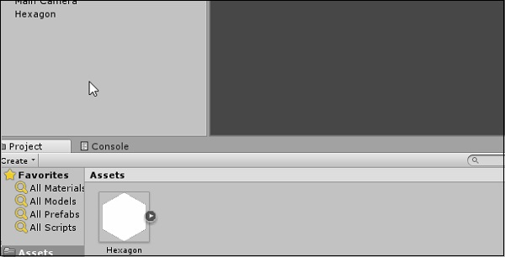
Understanding Prefabs and Instantiation
To create a prefab, you simply have to drag the desired GameObject from your scene hierarchy into the project Assets.
Image source: Unity.com

Slide 23
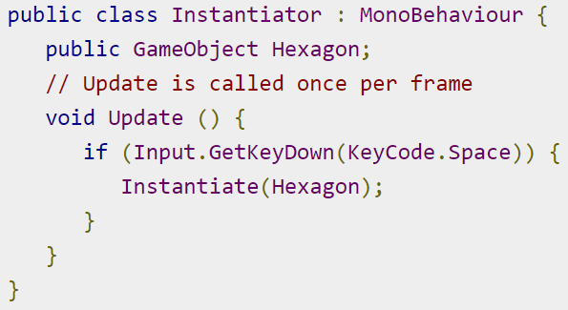
Understanding Prefabs and Instantiation
To instantiate a GameObject, we call the Instantiate() method in our script. This method, defined in MonoBehaviour, takes in a GameObject as a parameter, so it knows which GameObject to create/duplicate. It also has various overrides for changing the newly instantiated object’s transform, as well as parenting.
Example: try instantiating a new hexagon whenever the Space key is pressed.
Create a new script called Instantiator and open it up. In the Update method, type in the code given below.
Image source: Unity.com
Notes:
Here, we are using the GetKeyDown method of the Input class to check if the player pressed a specific button during the last frame. Since we want it to keep checking, we put it in Update, which runs 60 times per second. The GetKeyDown method returns true if the key specified by the KeyCode enum (which lists all possible keys on a standard keyboard) is pressed in that frame..
The public GameObject declaration at the top creates a slot similar to the one we made for the Rigidbody2D in our previous lessons. This slot only accepts prefabs (in editor time) and gameObjects (in runtime), however.

Slide 24
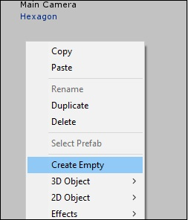
Understanding Prefabs and Instantiation
Using the GetKeyDown method of the Input class to check if the player pressed a specific button during the last frame
Save the script, and let it compile. Once it is done, create a new, empty GameObject by going to your object hierarchy right-click menu, and selecting Create Empty.
Image source: Unity.com

Slide 25
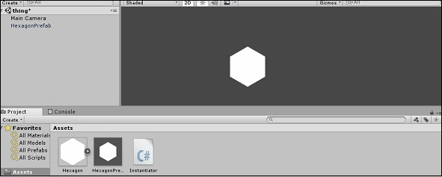
Understanding Prefabs and Instantiation
Name this Object something recognizable such as Instatiator Object and attach our newly created script to it. In the slot that shows up for the GameObject, drag in the prefab we created.
Image source: Unity.com

Slide 26
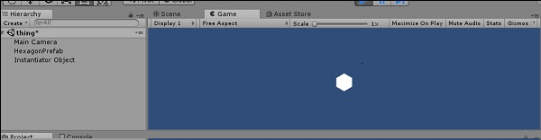
Understanding Prefabs and Instantiation
If we run the game now, pressing the Spacebar will create a new Hexagon object identical to the one we used to create the prefab. You can see each hexagon being created in the object hierarchy. The reason you cannot see them show up in the game is because for the time being, they are all being created exactly one over the other.
Image source: Unity.com

Slide 27
Understanding Prefabs and Instantiation
Name this Object something recognizable such as Instatiator Object and attach our newly created script to it. In the slot that shows up for the GameObject, drag in the prefab we created.
Image source: Unity.com

Slide 28
Understanding Prefabs and Instantiation
If we run the game now, pressing the Spacebar will create a new Hexagon object identical to the one we used to create the prefab. You can see each hexagon being created in the object hierarchy. The reason you cannot see them show up in the game is because for the time being, they are all being created exactly one over the other.
Image source: Unity.com

Slide 29
GameObject Destruction
The destruction of GameObjects is as important as the instantiation.
Use the Destroy() method to destroy a object: Destroy (gameObject)
where gameObject is a reference to the object to be destroyed.
It is important to understand that destroying a GameObject does not mean an object will shatter or explode. Destroying an object will simply (and immediately) cease its existence as far as the game (and its code) is concerned. The links to this object and its references are now broken, and trying to access or use either of them will usually result in errors and crashes.
Image source: Unity.com

Slide 30
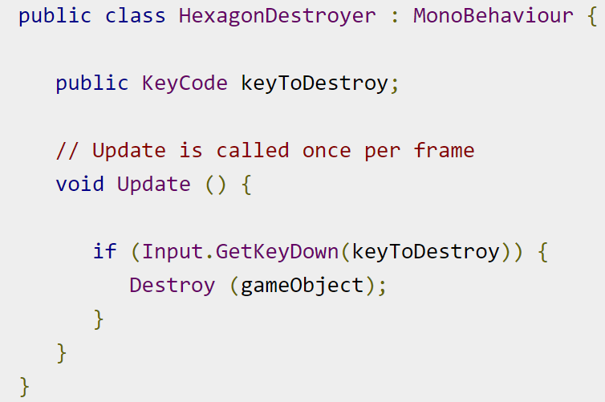
GameObject Destruction
Example: try to make 5 hexagons which will destroy themselves when an assigned key is pressed.
Image source: Unity.com
Notes:
Let us make a new script called HexagonDestroyer and open it in Visual Studio. We will start by making a public KeyCode variable. A KeyCode is used to specify a key on a standard keyboard, and the Input class in its methods uses it. By making this variable public, as we did with Rigidbody and Prefabs previously, we can make it accessible through the editor. When the variable is made public, we need not hardcode values such as “KeyCode.A” into the code. The code can be made flexible with as many objects as we want.

Slide 31
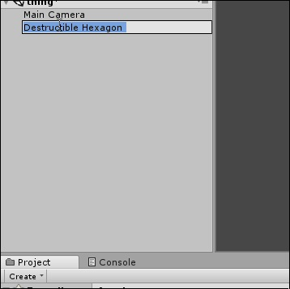
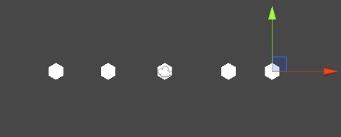
GameObject Destruction
Example:
Image source: Unity.com
Notes:
Let us now compile our code, and head back to Unity.
Now, we will create a new hexagon sprite, and attach our script to it. Next, right-click the gameObject in the hierarchy and select Duplicate. A new sprite is created in the hierarchy; you should use the Move tool to reposition it. Repeat the steps to create similar hexagons.
Click on each of the hexagons and look at their script components. You can now set the individual keys so that a GameObject destroys itself when that key is pressed. For example, let us create 5 hexagons, and set them to destroy when the A, S, D, F and G keys are pressed.
You can set the same key on multiple hexagons, and they will all destroy themselves simultaneously when the key is pressed; this is an example of the use of the gameObject reference, which you can use to refer to individual objects using the script without having to set them individually.
The same key can be set on multiple hexagons, and they will all destroy themselves simultaneously when the key is pressed; this is an example of the use of the gameObject reference, which you can use to refer to individual objects using the script without having to set them individually.

Slide 32
Basic Movement Scripting
Every GameObject has at least one component − Transform. What is special is that the Transform of a gameObject also shows up as variables in the scripting side of Unity so we can modify it via code. This is not restricted to the Transform either; all components in Unity have properties, which are accessible through variables in scripting.
Image source: Unity.com

Slide 33
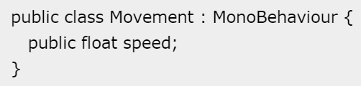
Basic Movement Scripting
Example:
Start with a movement script. Create a new script, and name it “Movement”.
Open the script and you should see the same stuff you saw in the last lesson.
Create a public float variable named speed. Making a variable public in Unity has a great advantage.
The variable shows up as a modifiable field inside the editor, so you don’t have to manually adjust the values in code.
Image source: Unity.com

Slide 34
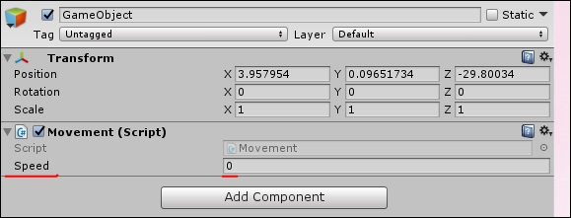
Basic Movement Scripting
Example:
Drag and drop the script from the Assets onto the GameObject. If you do it correctly, this is what you should see in the GameObject’s properties.
Since the speed value is adjustable and need not be changed in code all the time, we can use update() method instead of start().
Image source: Unity.com

Slide 35
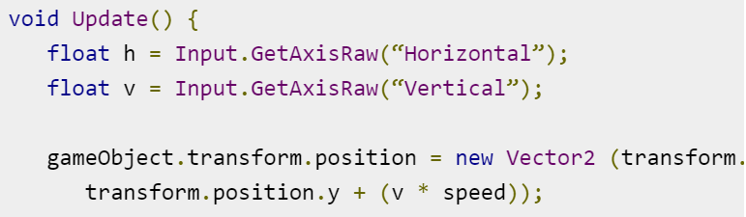
Basic Movement Scripting
Example:
Consider the objectives for the Update method:
Check for the user input.
If there is a user input, read the directions of input.
Change the position values of the object’s transform based on its speed and direction. To do so, we will add the following code
Image source: Unity.com
Notes:
First of all, we make a floating point variable named h (for horizontal), and its value is given by the Input.GetAxisRaw method. This method returns -1, 0 or 1 depending on which key the player has pressed on the up/down/left/right arrows.
The Input class is responsible for getting input from the user in the form of key presses, mouse input, controller input, and so on. The GetAxisRaw method is slightly harder to understand, so we’ll get back to that later.
Next, we are updating the position of our gameObject to a new position defined by creating a new Vector2. The Vector2 takes 2 parameters, which are its x and y values respectively. For the x value, we provide the sum of the object’s current position and its speed, effectively adding some amount every frame the key is pressed to its position.

Slide 36
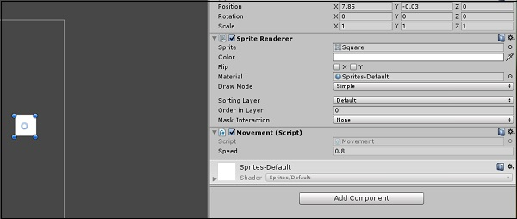
Basic Movement Scripting
Example:
Change the value of the speed in the GameObject’s properties to say 0.8. This is important because a higher value will make the player move too fast.
Image source: Unity.com
Notes:
Save this script and head back to Unity. Unity will automatically update all scripts once it compiles successfully, so you don’t have to reattach the script again and again.
Now that you are done, change the value of the speed in the GameObject’s properties to say 0.8. This is important because a higher value will make the player move too fast.

Slide 37
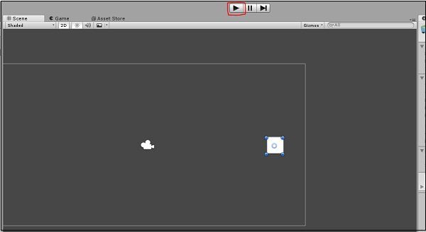
Basic Movement Scripting
Example:
Click Play and see your first small game in action
Image source: Unity.com
Notes:
Save this script and head back to Unity. Unity will automatically update all scripts once it compiles successfully, so you don’t have to reattach the script again and again.
Now that you are done, change the value of the speed in the GameObject’s properties to say 0.8. This is important because a higher value will make the player move too fast.
Click Play and see your first small game in action.
Try pressing the arrow keys and moving around. To stop the game, simply press Play again. You can even adjust the speed in real-time so you do not have to stop and start it all the time.

